Slide 1
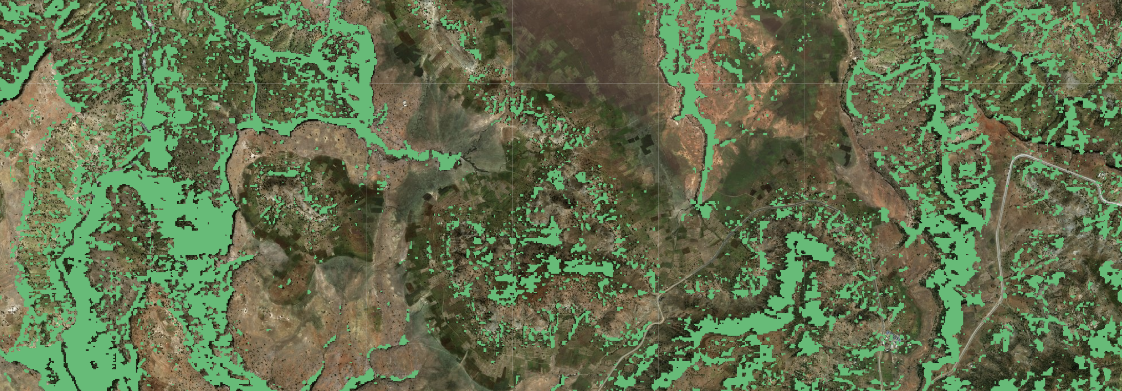
Monitoring trees outside the forest
John Brandt
World resources institute

Slide 2
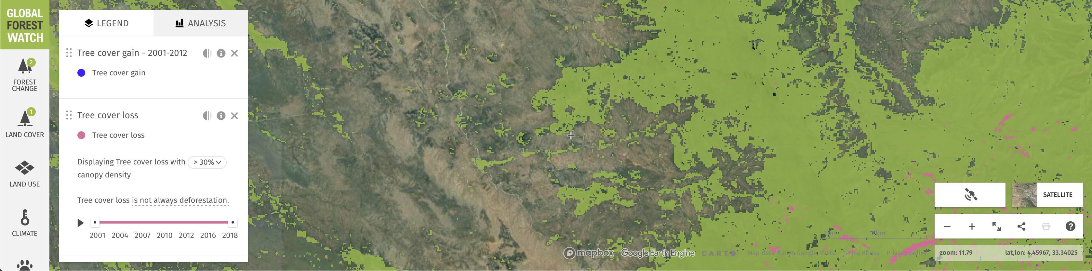
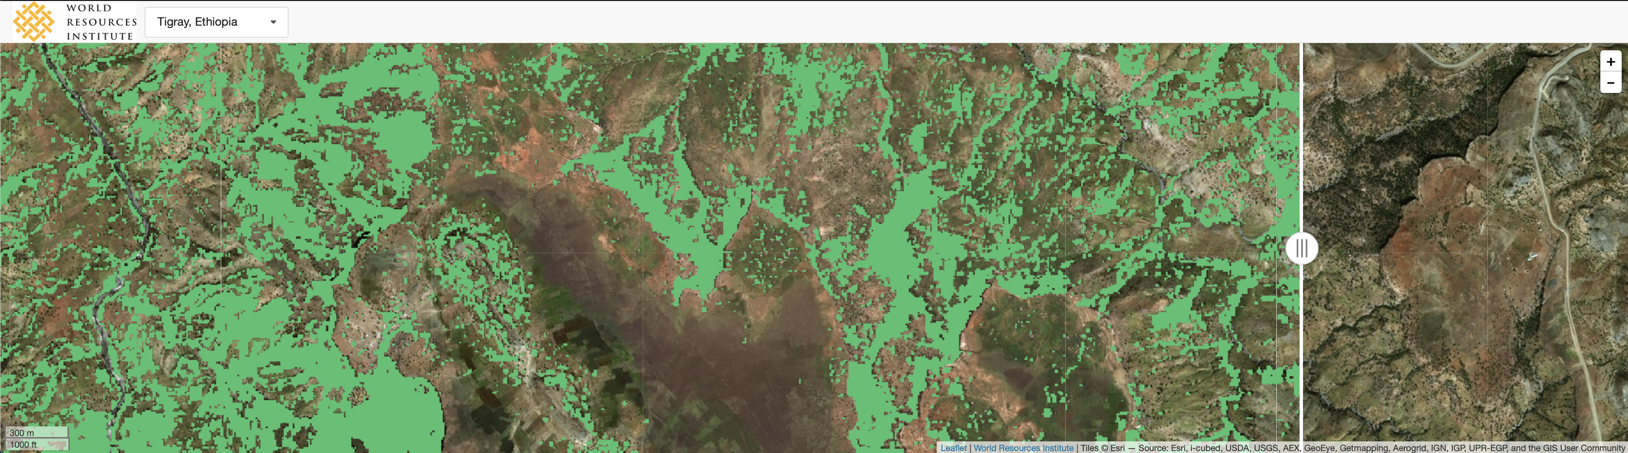
High-level differences w/ GFW
Project-level monitoring of avoided deforestation and deforestation risk with Global Forest Watch
Project-level mapping of individual trees outside of the forest

Slide 3
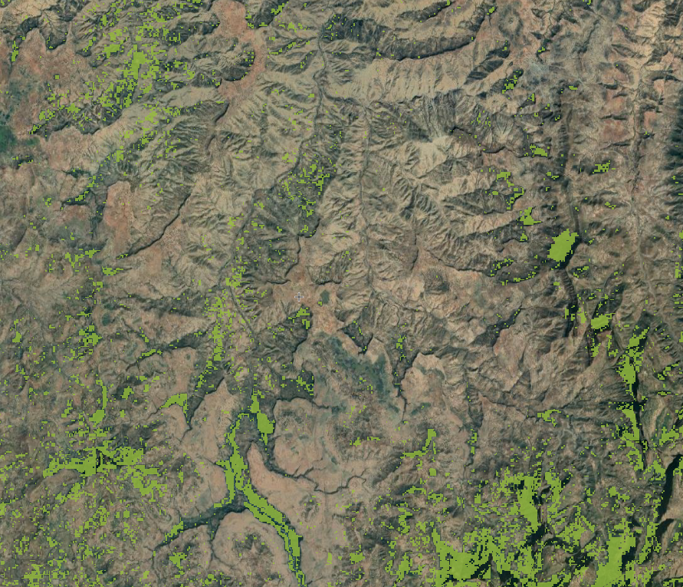
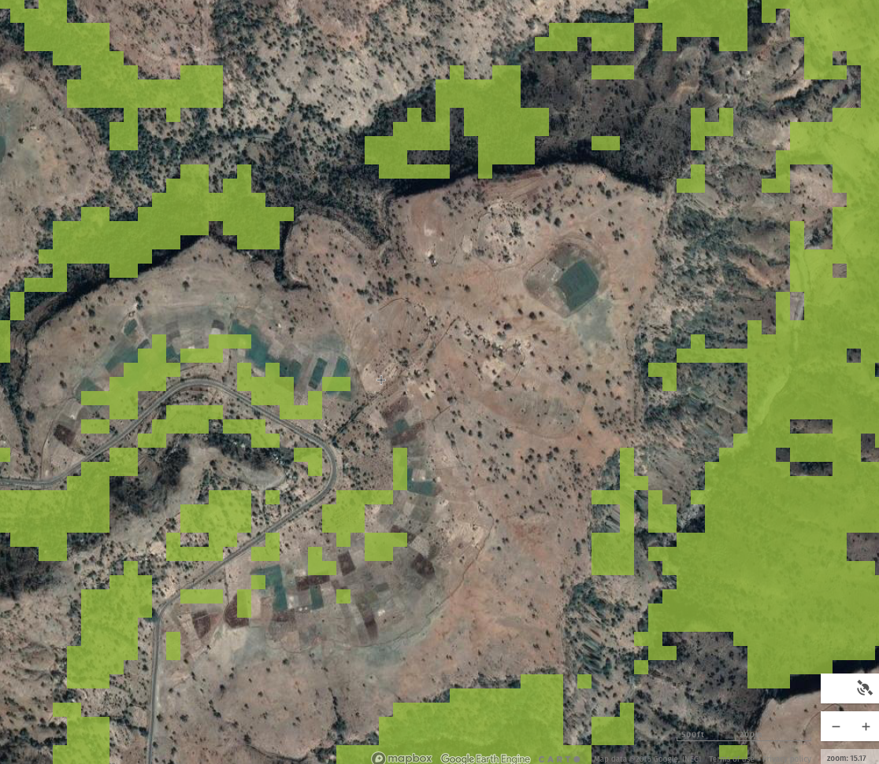
Tigray, ethiopia

Slide 4
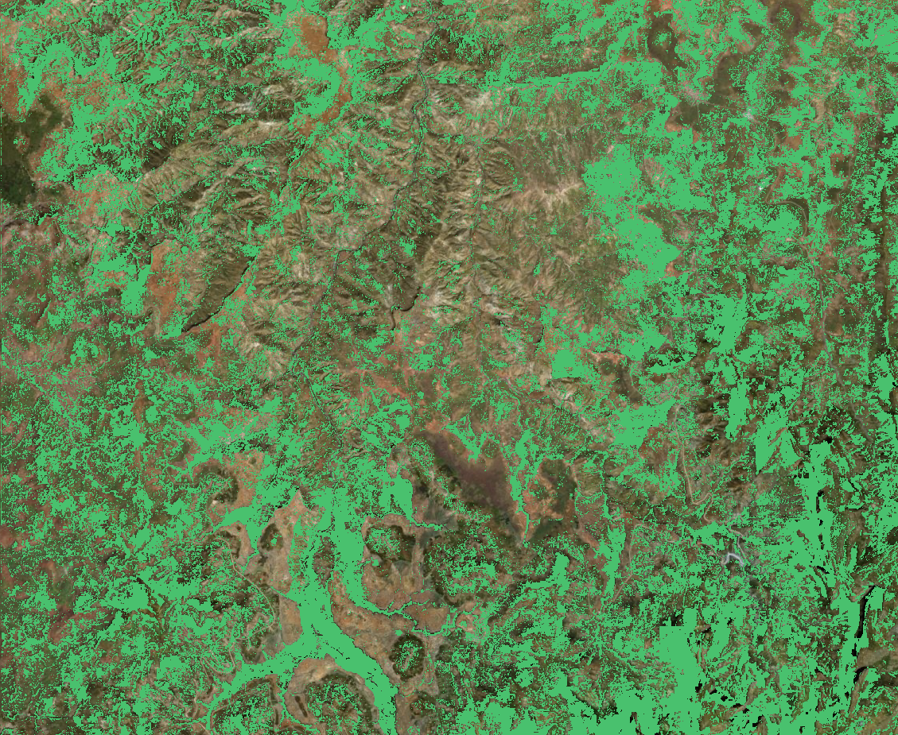
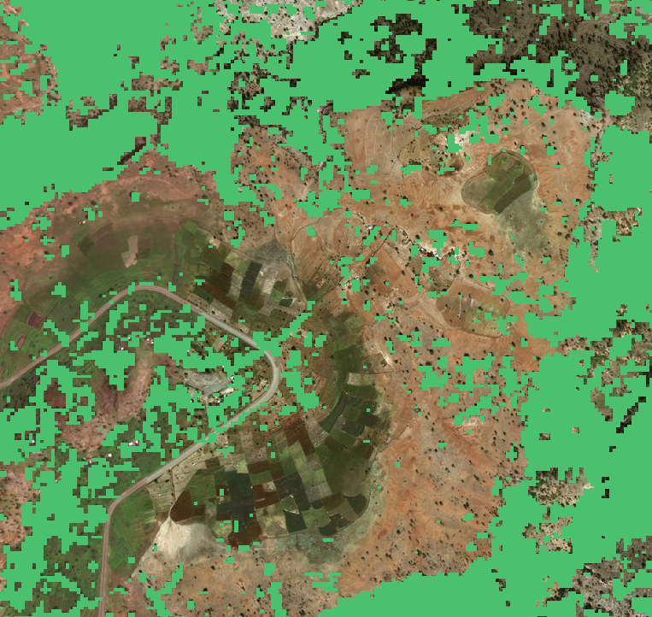
Tigray, Ethiopia

Slide 5
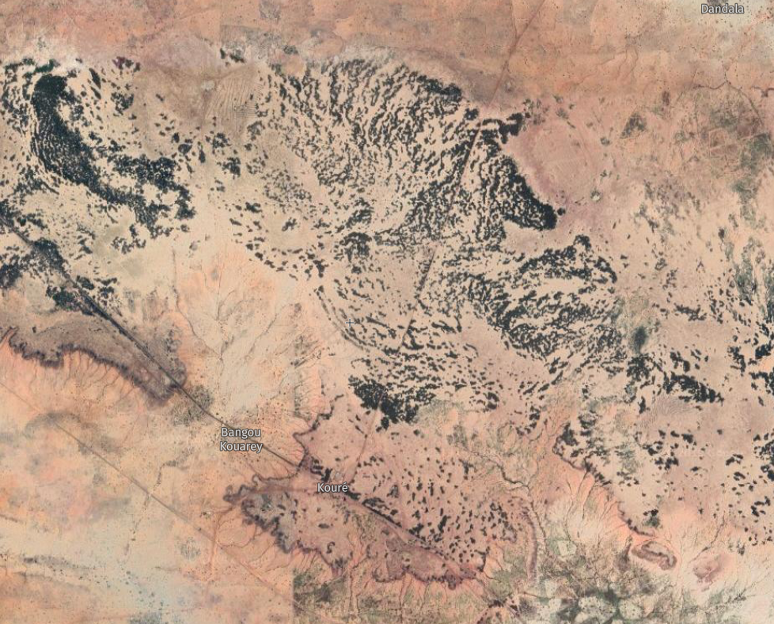
Koure, Niger

Slide 6
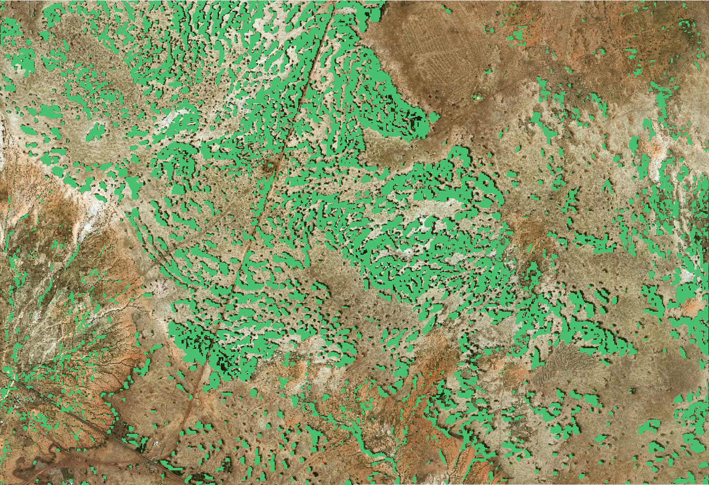
Koure, Niger

Slide 7
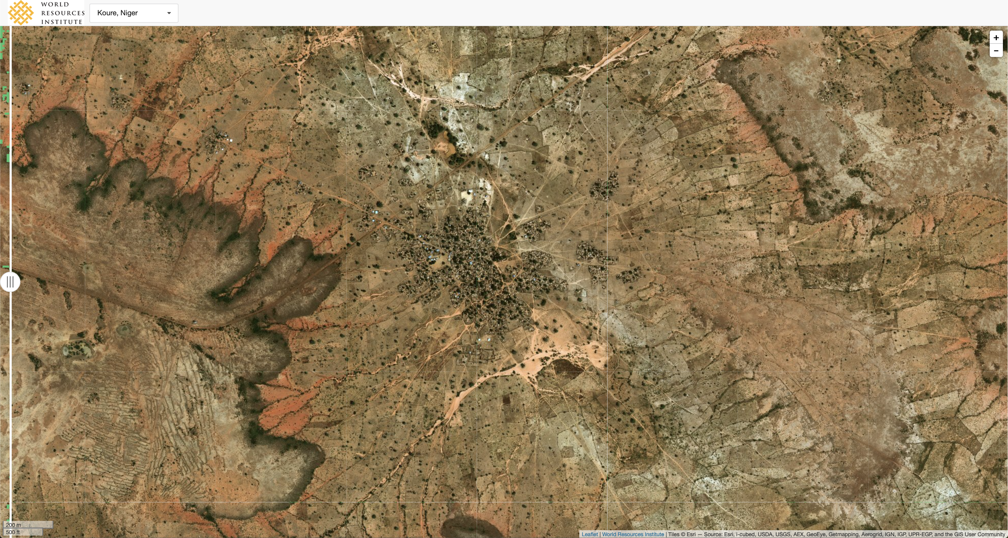
5,000 ha village and farm land - Koure

Slide 8
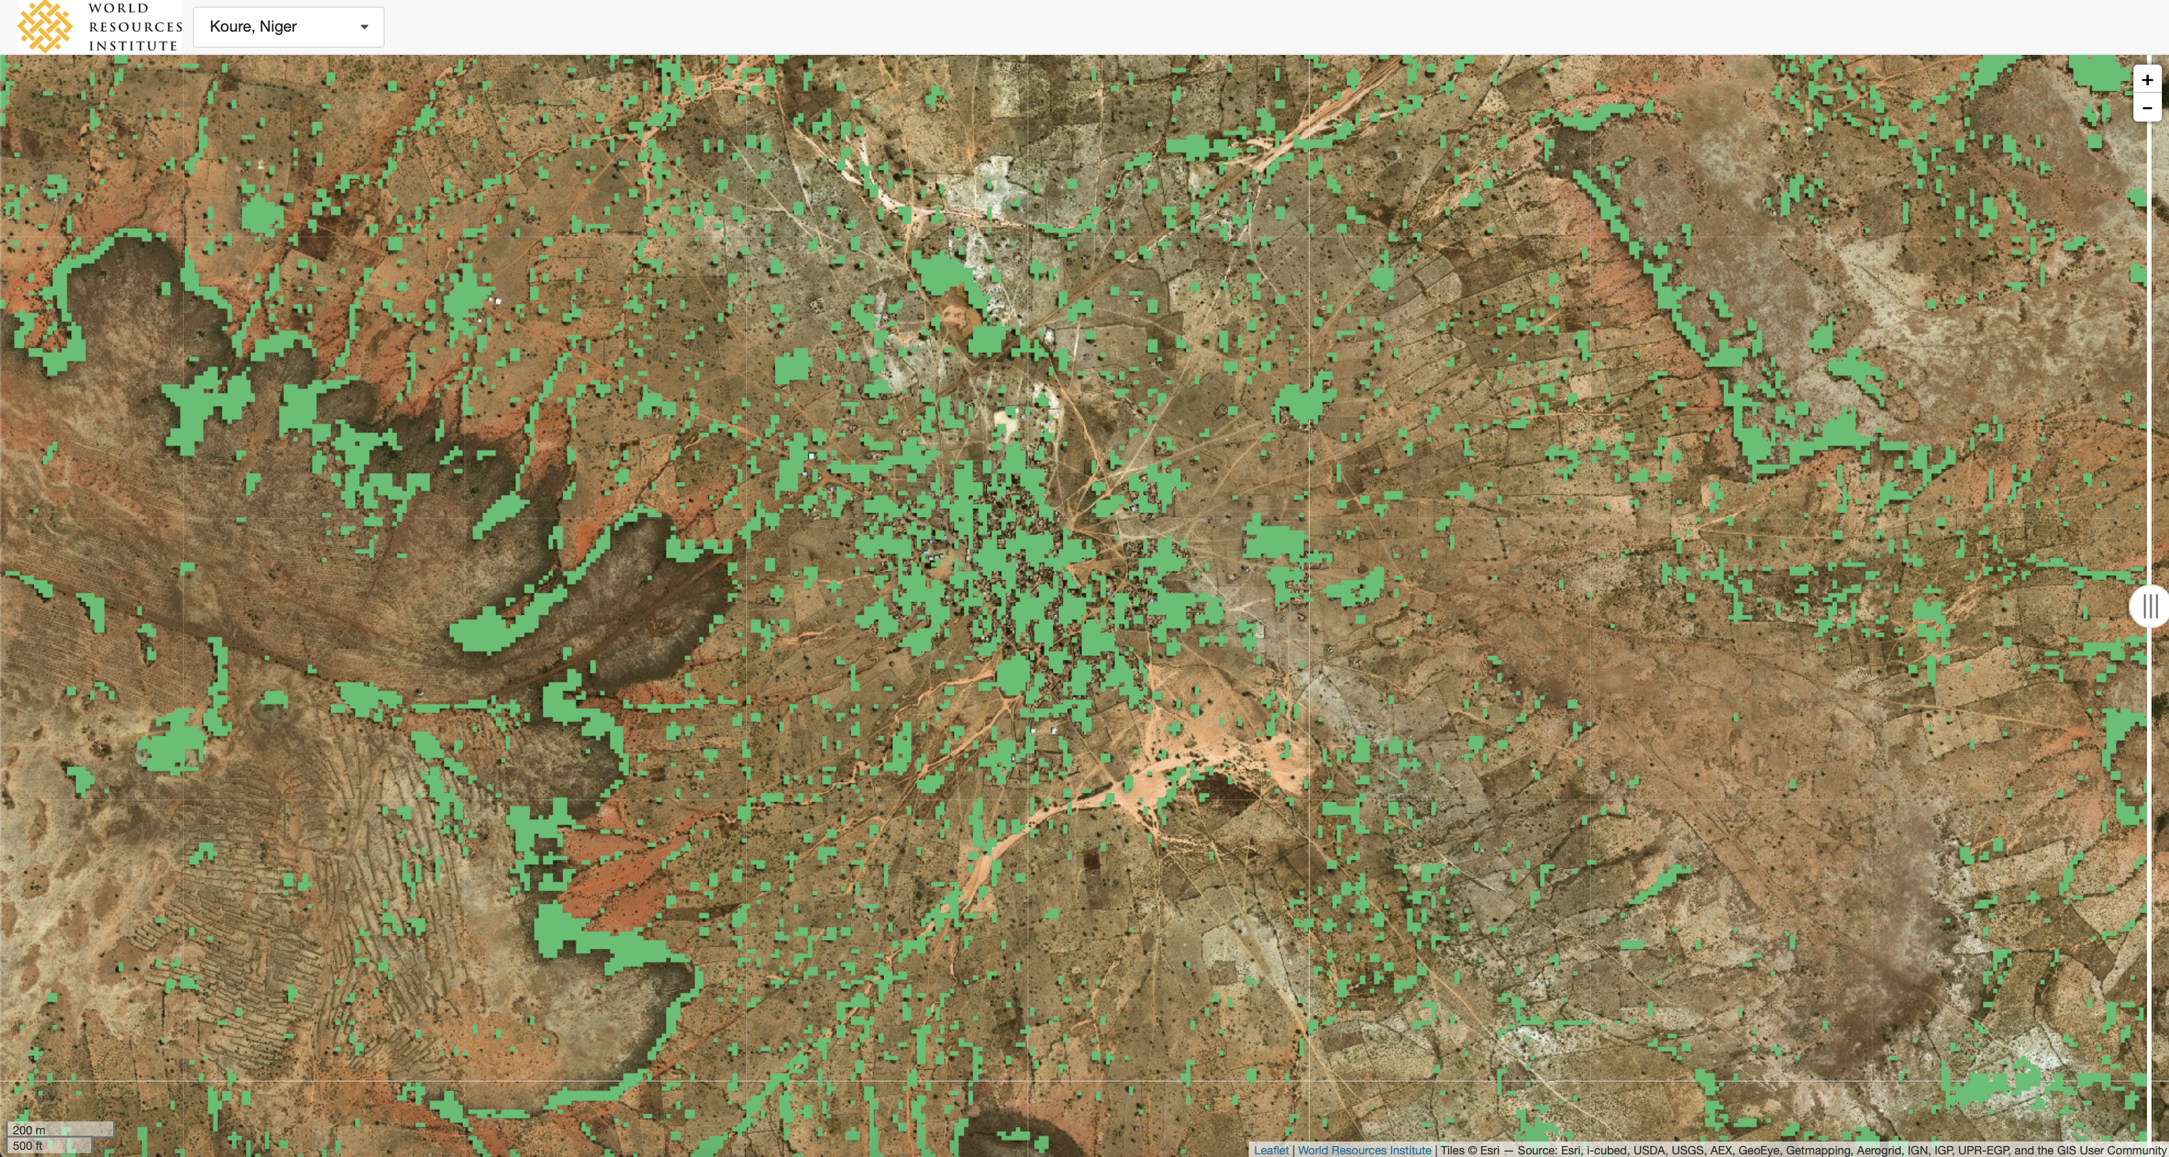
5,000 ha village and farm land - Koure

Slide 9
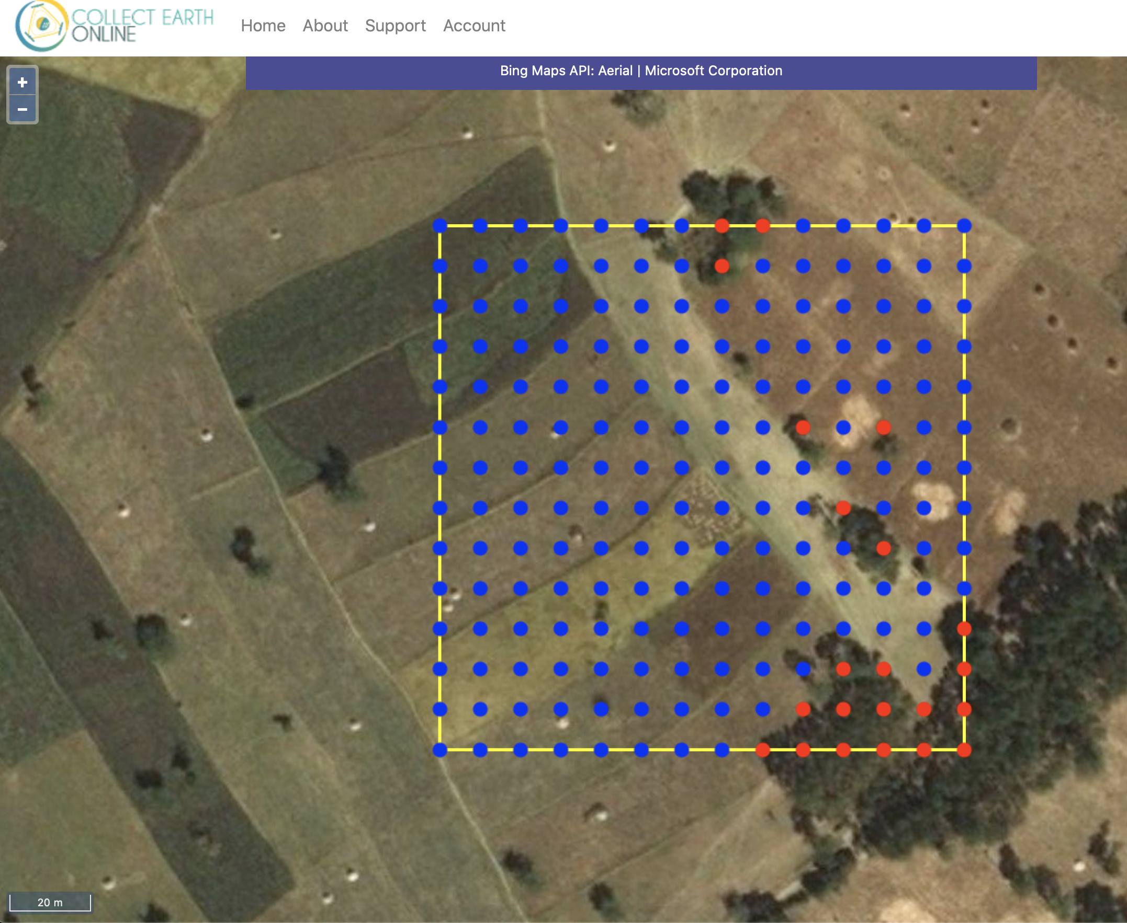
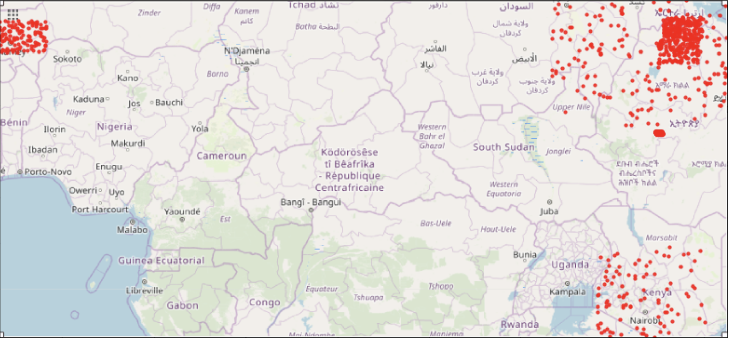
DATA
1,000 2 hectare plots
Randomly sampled
Northern Ethiopia
Kenya
Niger
Tanzania
Sudan

Slide 10
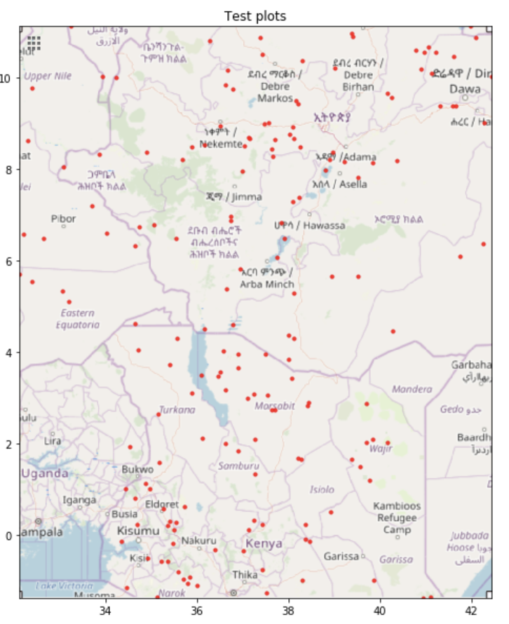
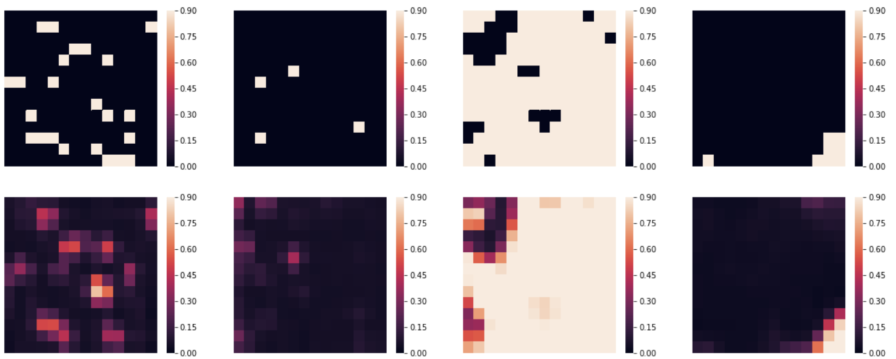
Data
200 2 hectare plots
Sampled across
Southern Ethiopia
Kenya
South Sudan

Slide 11
Metrics
Prediction speed: 312,000 ha/hour/core
Suggests ability to detect <1% tree cover difference at 2 ha scale outside of forests
Tree cover % | Precision @ 10 m | Recall @ 10 m | Percent error @ 2 ha
50+ | 90% | 88% | 0.5%
20-50 | 78% | 75% | 0.5%
<20 | 75% | 77% | 1.2%
Overall | 81% | 79% | 0.2%

Slide 12
Next steps
Research questions
Performance with high cloud cover, plantations
Performance assessment for varying tree sizes
Analysis of how many samples are necessary to accurately assess new geographic regions
Identify how this work fits in with other monitoring efforts
Priority landscapes
Easy: Koure, Niger; Rhumpi, Malawi
Short-term: Makueni, Kenya; Pra River Basin, Ghana
Long-term: Landscapes in Mexico, India, Brazil, El Salvador

Slide 13
Development Roadmap
Small cloud removal
Data storage streamlining
Radar data fusion with sentinel-1 (2 weeks)
Upscaling 20m to 10m (2 weeks)
Large-data download tiling (1 week)
Cloud-optimized geotiffs (1 week)
Post-processing (i.e. trees between pixels) (1 week)
Cloud engineering and deployment (3 weeks)
Make 100-200k ha maps of all priority landscapes
Current online total 180k ha @ 81% UA/PA
Goal is 2,250k ha @ 86% UA/PA
Develop unit, integration tests, ID and fix bugs (2 weeks)
1-2m ha scale maps
Malawi, Niger, Ghana, Kenya, Cameroon

Slide 14
